Slide 1
BOTSWANA CUSTOMER PRICE Index study
A look into Botswana’s Inflation Rates and whether or not they can be predicted.

Slide 2
INTRODUCTION
Inflation is the increase in price of general goods and services in a country.
The most popular measure of inflation is CPI (Customer Price Index).
Central Bank of a country looks to control inflation in order to stabilize the country’s economy and attract investors.
Central Banks control inflation using monetary policy instruments. A major example is the interest rate at which they lend money to commercial banks. Another example is imposing reserve requirement for commercial banks.
The central bank of Botswana is called the Bank of Botswana.

Slide 3
Data Sourcing
The data for this project was sourced from the Bank of Botswana website and the exchange rate data for South Africa is from the South African Reserve Bank website.
The data came in the form of csv files. There was a file for CPI data, one for exchange rate data, and another one for interest rates. The tables were joined together based on the date field.
The data was assumed to be coming from a reliable source since it was extracted from official central bank websites.

Slide 4
Data content
The Bank has an objective to keep inflation rate between 3 and 6 percent and makes adjustment to interest rates through its monetary policy tools. This is expected to have a significant impact on the data.
The data includes exchange rates for Pula (Botswana’s currency) with Special Drawing Rights as well as the 5 currencies that influence them. Namely: Chinese Renminbi (CHN), USD, GBP, EUR, and YEN. It also includes the exchange rate for the South African Rand which is known to have a big impact on Botswana’s inflation rate.
The data also includes Interest Rates for Bank of Botswana Certificates (BOBC’s). This includes the BOBC 7 DAYS (7 days to maturity) and BOBC 1 MONTH (1 month to maturity). This is how the Central Bank makes short term loans to commercial banks.
There are also fields for CPI, CPIXA, AND CPIT. These are all measures of inflation. It was decided that CPI would be used as the main measure, and so it was the target variable for modelling.

Slide 5
Data Wrangling
Three tables were joined to create the dataset that was used.
The resulting table had a lot of missing values that needed addressing.
For the 1 month BOBC, it only started being used in 2022. So most of its values were missing. It was kept and filled using forward fill, but it could’ve also been removed from the data.
Currency data were filled using average values.
CPI data was forward filled since it came as monthly data instead of daily data.

Slide 6
EXPLORATORY DATA ANALYSIS
As can be seen in the next slide, CPI has peaked around 2008 and in 2022.
In 2008, it was likely caused by the well known recession that occurred at that time.
In 2022, there was a war between Russia and Ukraine and the after effects of Covid 19 were still in effect.
After Covid, the Bank made a decision to keep interest rates very low in order to boost the economy. This can be seen in the next slide. It is generally known that low interest rates result in high inflation.

Slide 7
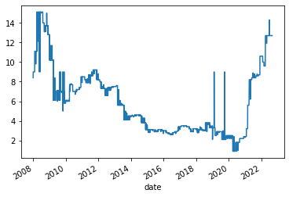
Cpi levels from 2008 to 2022

Slide 8
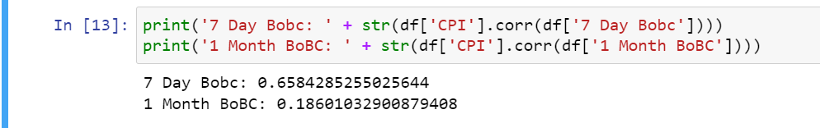
CPI vs Interest Rate
According to the image, the BOBC 7 Days Interest rate has a moderately strong positive correlation with CPI.
It is usually expected to be negative. This could be caused by how the central bank responds to rapidly rising inflation: they increase interest rates so the inflation can drop.
The effect of increasing interest rates does not take place immediately, it takes time.

Slide 9
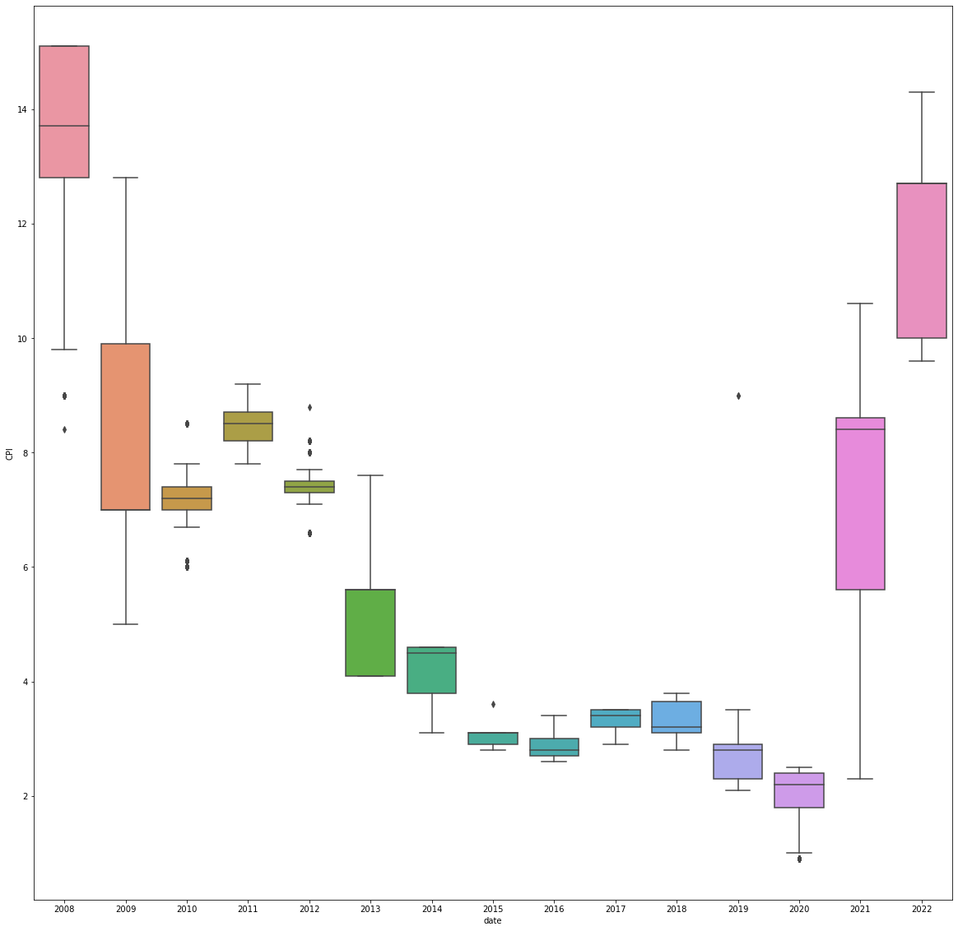
CPI DISTRIBUTIONS from 2008 to 2022

Slide 10
CPI DISTRIBUTIONS FROM 2008 TO 2022
CPI distribution does not vary much except around 2008 and 2022.
As discussed earlier, the variance in those years is likely due to the global recession and Covid 19/War between Russia and Ukraine.
The central bank looks to stabilize the CPI and keep it between 3 and 6% as they managed to do this quite effectively from 2015 to 2020.

Slide 11
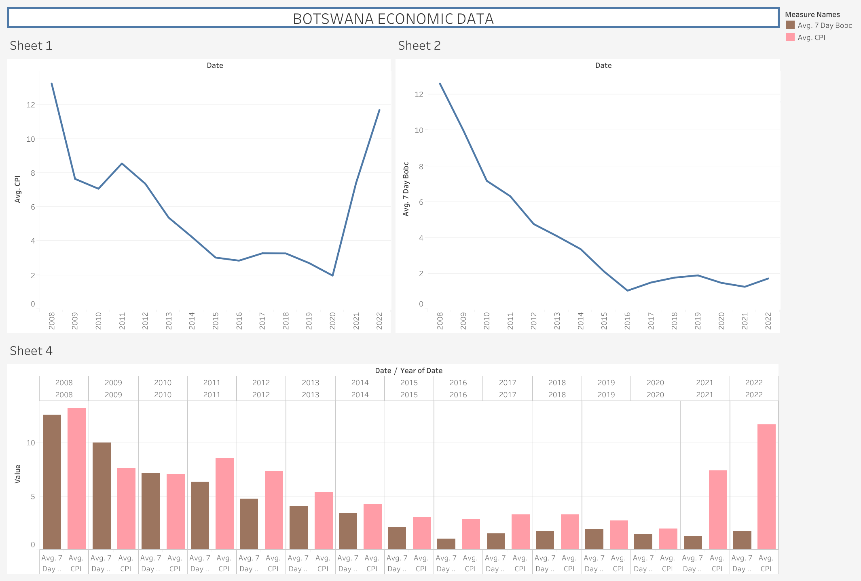
A Dashboard showing Cpi trends compared with interest rates (bobc 7 days)

Slide 12
Conclusion
There wasn’t much of a correlation between CPI and the currencies in the dataset. USD had the highest correlation of 0.599.
Interest rate clearly had an immense impact on CPI. It was the main monetary tool used to control inflation rates.
The true effect of interest rate isn’t very clear because it is used in response to events that affect the economy. The central bank predicts the effects of events on inflation and responds by setting interest rates that will bring inflation back to the range of 3% to 6%.

